Slide 1
ARTIFICIAL INTELLIGENCE CLASS 8 ☺
BY
GIRISH
KEERTHIVASAN

Slide 2
PANDAS
Pandas is one of the most popular data wrangling and analysis tools because it
Has the capability to load huge sizes of data easily
Provides us with extremely streamlined forms of data representation
Can handle heterogenous data, has extensive set of data manipulation features and makes data flexible and customizable

Slide 3
SUB DIVISIONS
The basic data structures of Pandas are Series and DataFrame.
pd.Series(data, index, dtype)
data – It can be a list, a list of lists or even a dictionary.
index – The index can be explicitly defined for different valuesif required.
dtype – This represents the data type used in the series (optional parameter).

Slide 4
DATA FRAMES
pd.DataFrame(data, index, columns)
data - data can contain Series or list-like objects. If data is a dictionary, column order follows insertion-order.
index- index for dataframe that is created. By default, it will be RangeIndex(0, 1, 2, …, n) if no explicit index is provided
columns- If data contains column labels, it will use the same . Else, default to RangeIndex(0, 1, 2, …, n).

Slide 5
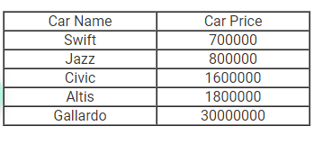
EXAMPLES

Slide 6
TOPICS
SERIES (INDEX,VALUE,ACCESS)
TABLE
DICTIONARY
COMBINING
DATAFRAMES

Slide 7
GOOGLE COLAB
https://colab.research.google.com/drive/1MvVmUh7lrdwTqgo2zhgIB1SbktFmL0eO?usp=sharing

